Slide 1
Adversarial Search Session 05
Course : COMP6065001 Artificial Intelligence
Effective Period : September 2023

Slide 2
Learning Outcomes
At the end of this session, students will be able to:
LO 1: Describe what is AI and identify concept of intelligent agent
LO 2: Explain various intelligent search algorithms to solve the problems

Slide 3
Outline
Games
Optimal Decision in Games (Minimax Algorithm)
Alpha-Beta Pruning
Imperfect Real-Time Decisions
Exercise

Slide 4
Games
Games is a search problems
How we can find the best solution while predicting the opponent’s move?
Multiagent environments which the relation between agents is competitive
The agents’ goal are in conflict (I and opponent)

Slide 5
Games
Games are interesting because they are too hard to solve
For example, chess has an average branching factor of about 35, and games often go to 50 moves by each player
So the search tree has about 35¹⁰⁰ or 10¹⁵⁴ nodes
Games like the real world
Require the ability to make some decision even when the optimal decision is infeasible
Also penalize inefficiency severely

Slide 6
Kind of Games
Abstraction: To describe a game we must capture every relevant aspect of the game, such as:
Chess
Tic-tac-toe
Accessible environments: Such games are characterized by perfect information

Slide 7
Kind of Games
Unpredictable opponent: introduces uncertainty thus, game-playing must deal with contingency problems
Pruning allows us to ignore portions of the search tree that make no difference to the final choice
Heuristic evaluation functions allow us to approximate the true utility of a state without doing a complete search

Slide 8
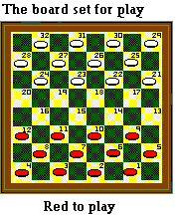
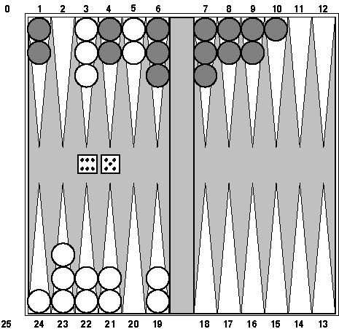
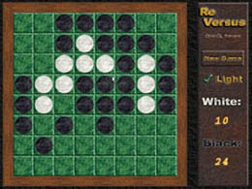
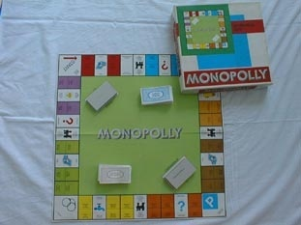
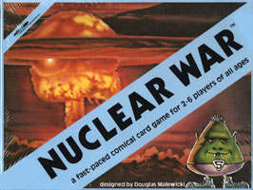
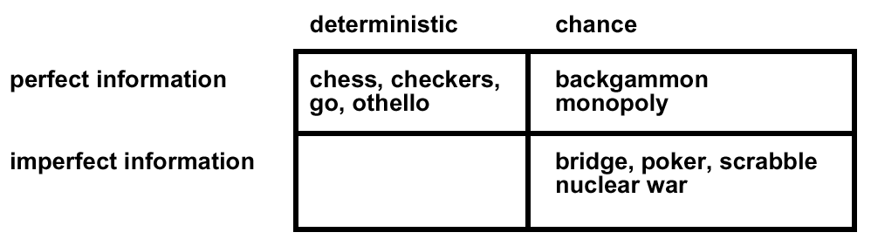
Kind of Games

Slide 9
Kind of Games
A game can be formally defined as a kind of search problem with the following elements:
The initial state → ?
Player(s) → ?
Actions(s) → ?
Result(s, a) → ?
Terminal-test → ?
Utility function/ objective function/ payoff function → ?

Slide 10
Optimal Decisions in Game
In a normal search problem, the optimal solution would be a sequence of actions leading to a goal state
In adversarial search, MIN has something so say about it
MAX must find a contingent strategy
An optimal solution of MAX is the move that MIN has the worst of optimal solutions
This definition of optimal play for MAX assumes that MIN also plays optimally—it maximizes the worst-case outcome for MAX.

Slide 11
Optimal Decisions in Game
Terminal positions, where MAX wins (score: +infinity) or MIN wins (score: -infinity).
The ply of a node is the number of moves needed to reach that node (i.e. arcs from the root of the tree).
The ply of a tree is the maximum of the plies of its nodes (or layer of nodes).

Slide 12
Minimax Strategy
Considering two-player, take turns and try respectively to maximize and minimize a scoring function and called MAX and MIN
We assume that the MAX player makes the first move
Represented the game as a tree where the nodes represent the current position and the arcs represent moves
Since players take turns, successive nodes represent positions where different players must move

Slide 13
Minimax Strategy
The Minimax game strategy for the MAX (MIN) player is to select the move that leads to the successor node with the highest (lowest) score.
The scores are computed starting from the leaves of the tree and backing up their scores to their predecessor in accordance with the Minimax strategy.

Slide 14
Minimax Strategy
Basic Idea: choose move with highest minimax value = best achievable payoff against best play
Algorithm:
Generate game tree completely
Determine utility of each terminal state
Propagate the utility values upward in the three by applying MIN and MAX operators on the nodes in the current level
At the root node use minimax decision to select the move with the max (of the min) utility value

Slide 15
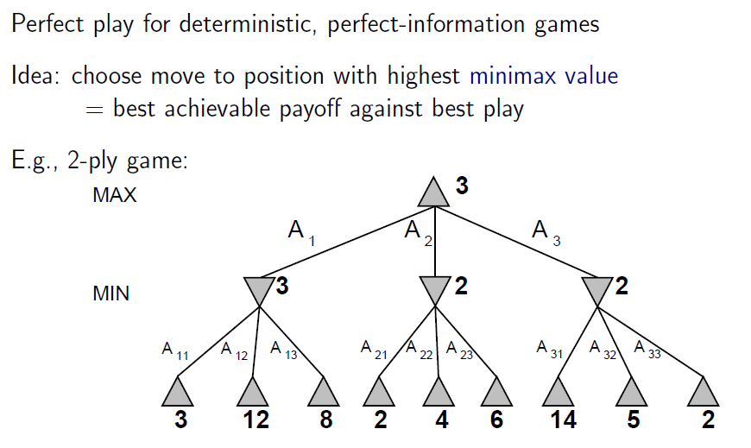
Minimax Strategy

Slide 16
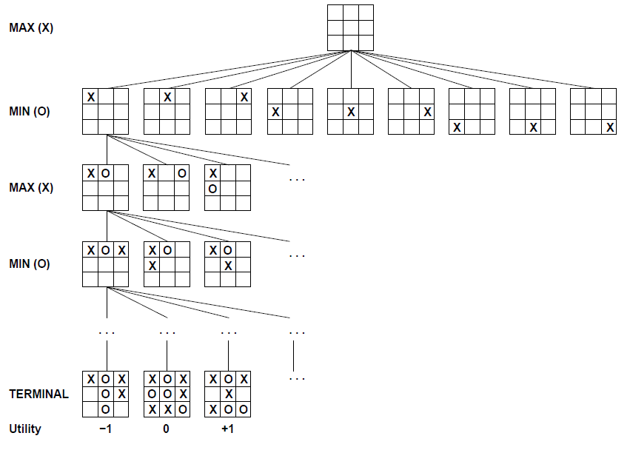
Game Tree

Slide 17
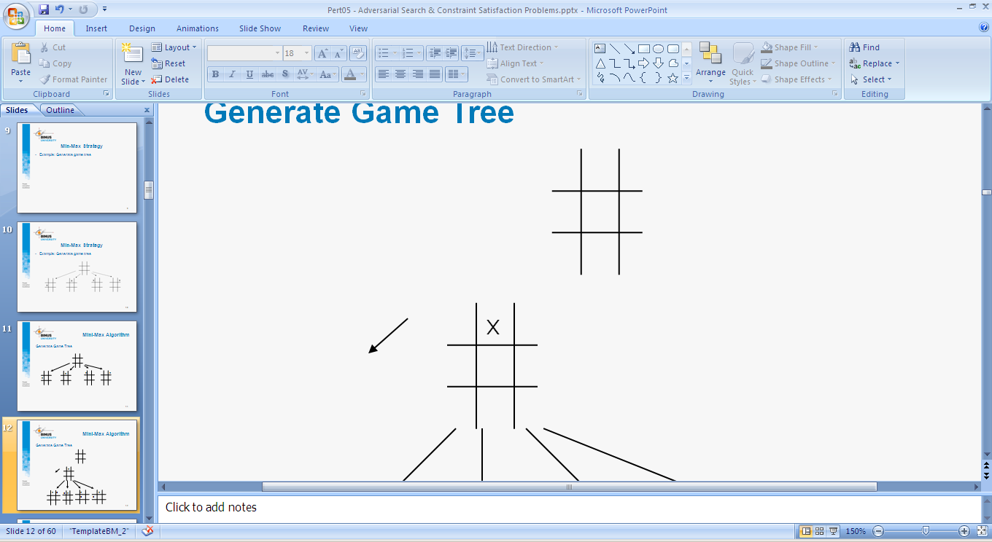
Minimax Strategy
Example: Generate game tree

Slide 18
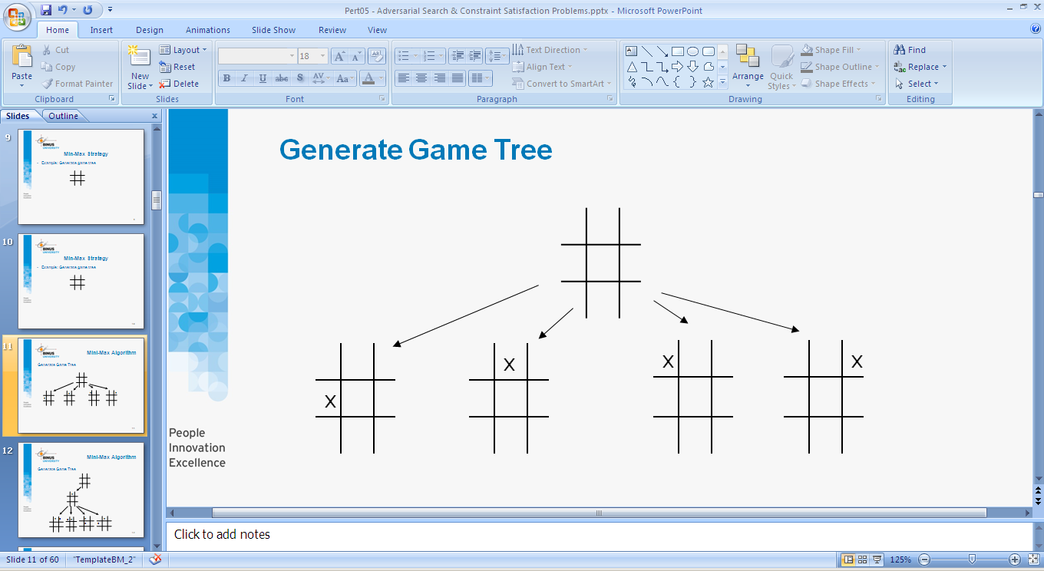
Minimax Strategy
Example: Generate game tree

Slide 19
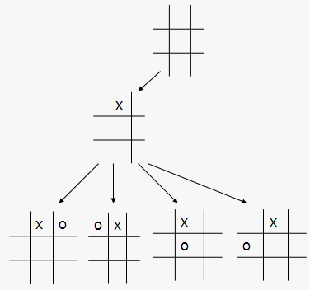
Minimax Strategy
Example: Generate game tree

Slide 20
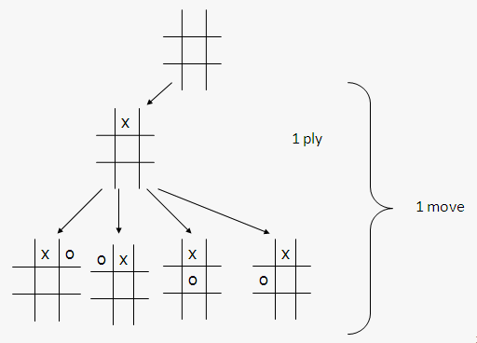
Minimax Strategy
Example: Generate game tree

Slide 21
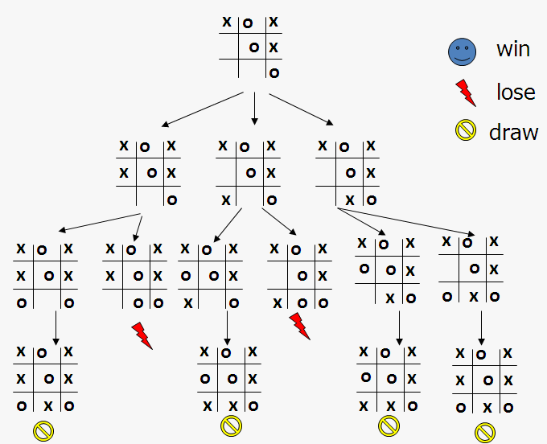
Minimax Strategy
Example: A sub tree of a game tree

Slide 22
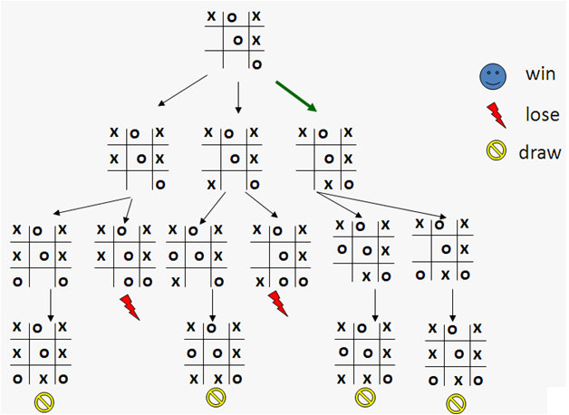
Minimax Strategy
What is a good move?

Slide 23
Alpha-Beta Pruning
Pruning: eliminating a branch of the search tree from consideration without exhaustive examination of each node
α-β pruning: the basic idea is to prune portions of the search tree that cannot improve the utility value of the max or min node, by just considering the values of nodes seen so far
α = highest-value, choice point along the path for MAX
β = lowest-value, choice point along the path for MIN

Slide 24
Alpha-Beta Pruning
≥ 6
MAX
MIN
6
α = highest value
β = lowest value
6
12
8

Slide 25
Alpha-Beta Pruning
≥ 6
MAX
MIN
6
≤ 2
Note that whatever x value, it must be 2 or smaller than 2
Thus, it would not change the final result
6
12
8
2
Result = max(min(6,12,8),min(2,x,x))
= max(12,min(2,x,x))
= 12

Slide 26
Alpha-Beta Pruning
MAX
≥ 6
MIN
6
≤ 2
≤ 5
6
12
8
2
14

Slide 27
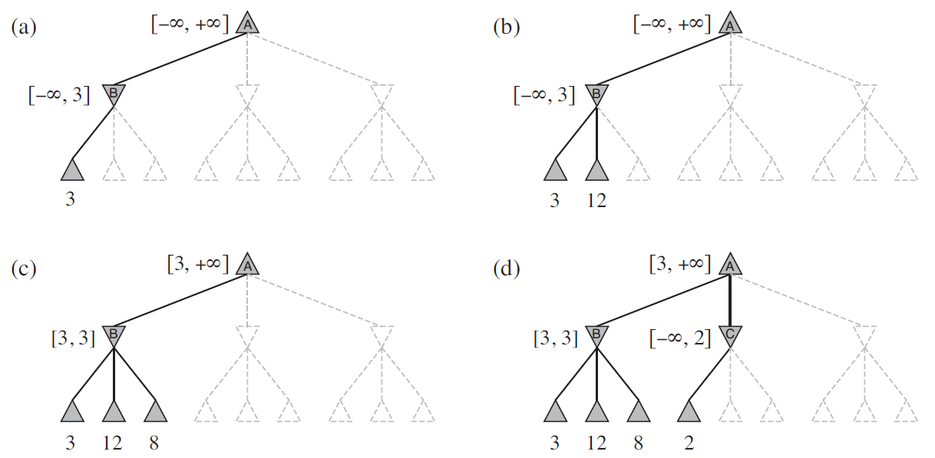
Alpha-Beta Pruning

Slide 28
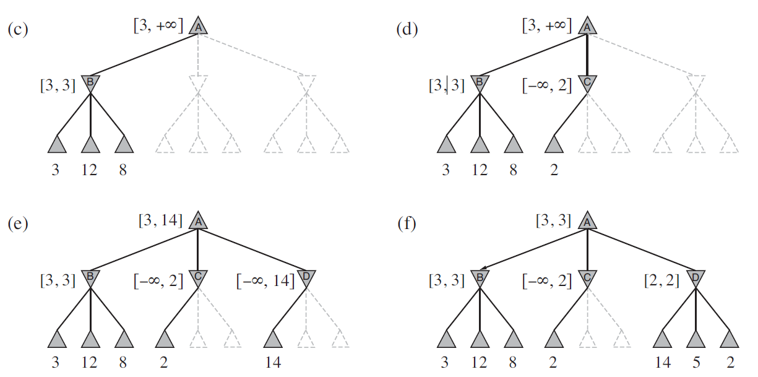
Alpha-Beta Pruning

Slide 29
Alpha-Beta Pruning
MAX
≥ 6
Selected move
MIN
6
≤ 2
≤ 5
6
12
8
2
14
5
8

Slide 30
Imperfect Real-Time Decisions
Complete search is too complex and impractical
Claude Shannon’s paper Programming a Computer for Playing Chess (1950) proposed to alter minimax or alpha-beta in two ways:
Replace the utility function by heuristic evaluation function Eval, which estimates the position’s utility
Replace terminal test by a cutoff test that decides when to apply Eval

Slide 31
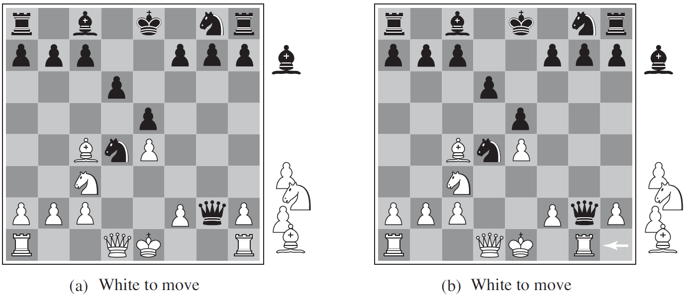
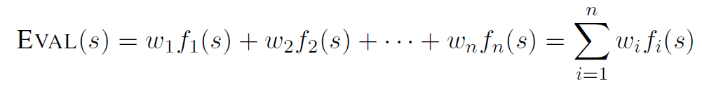
Imperfect Real-Time Decisions
Weighted linear function: to combine n heuristics
e.g.
w’s could be the values of pieces (1 for prawn, 3 for bishop etc.)
f’s could be the number of type of pieces on the board

Slide 32
Imperfect Real-Time Decisions

Slide 33
References
Stuart Russell, Peter Norvig. 2010. Artificial Intelligence : A Modern Approach. Pearson Education. New Jersey. ISBN:9780132071482

Slide 34
Exercise

Slide 35
Exercise
Given a Min-Max tree as below, describe in your own figure how the process of Alpha-Beta Pruning is executed to the tree!

